Slide 1
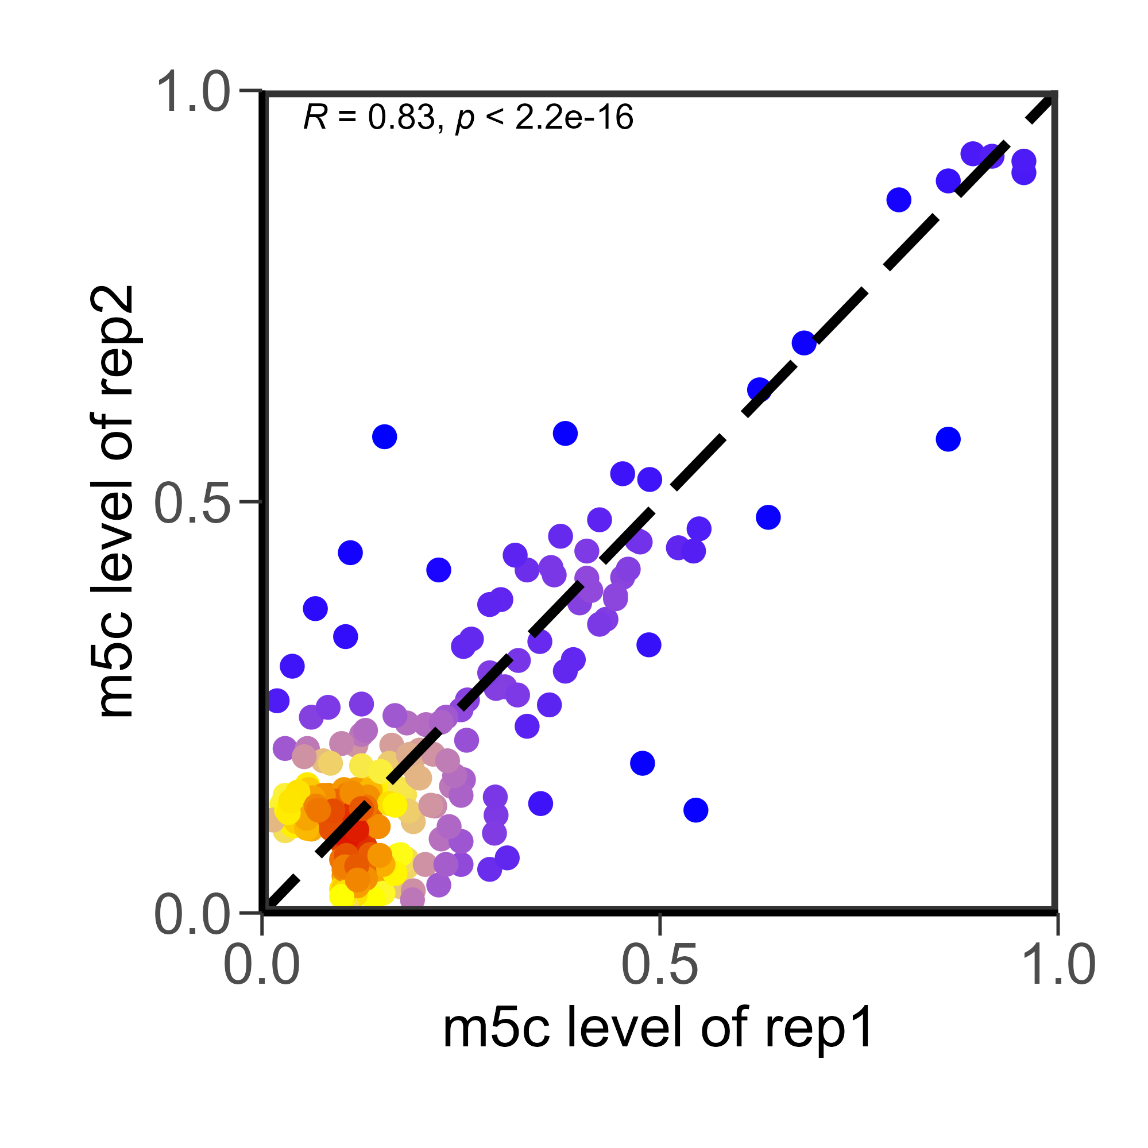
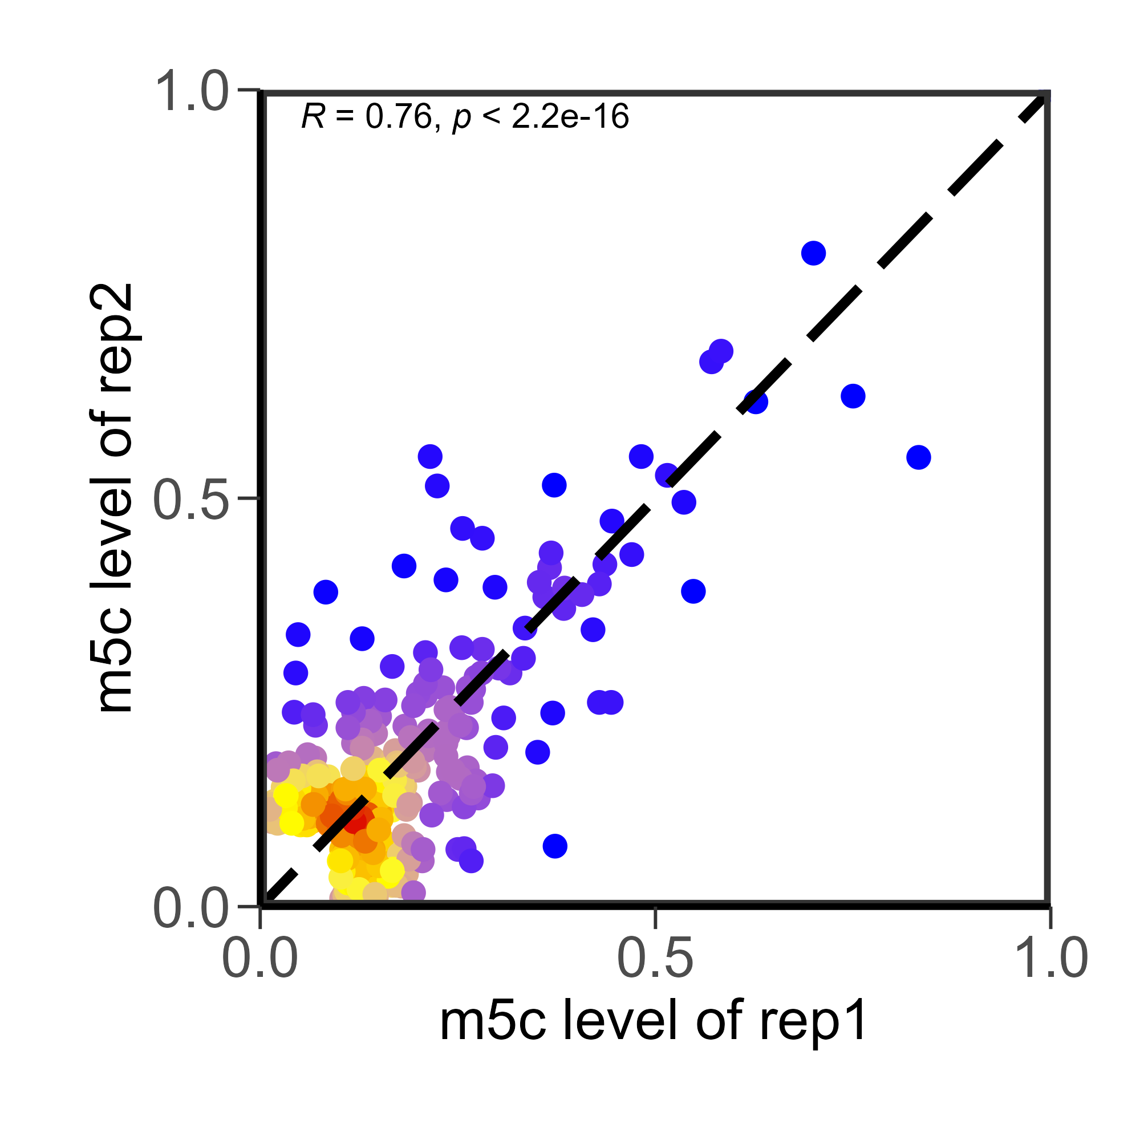
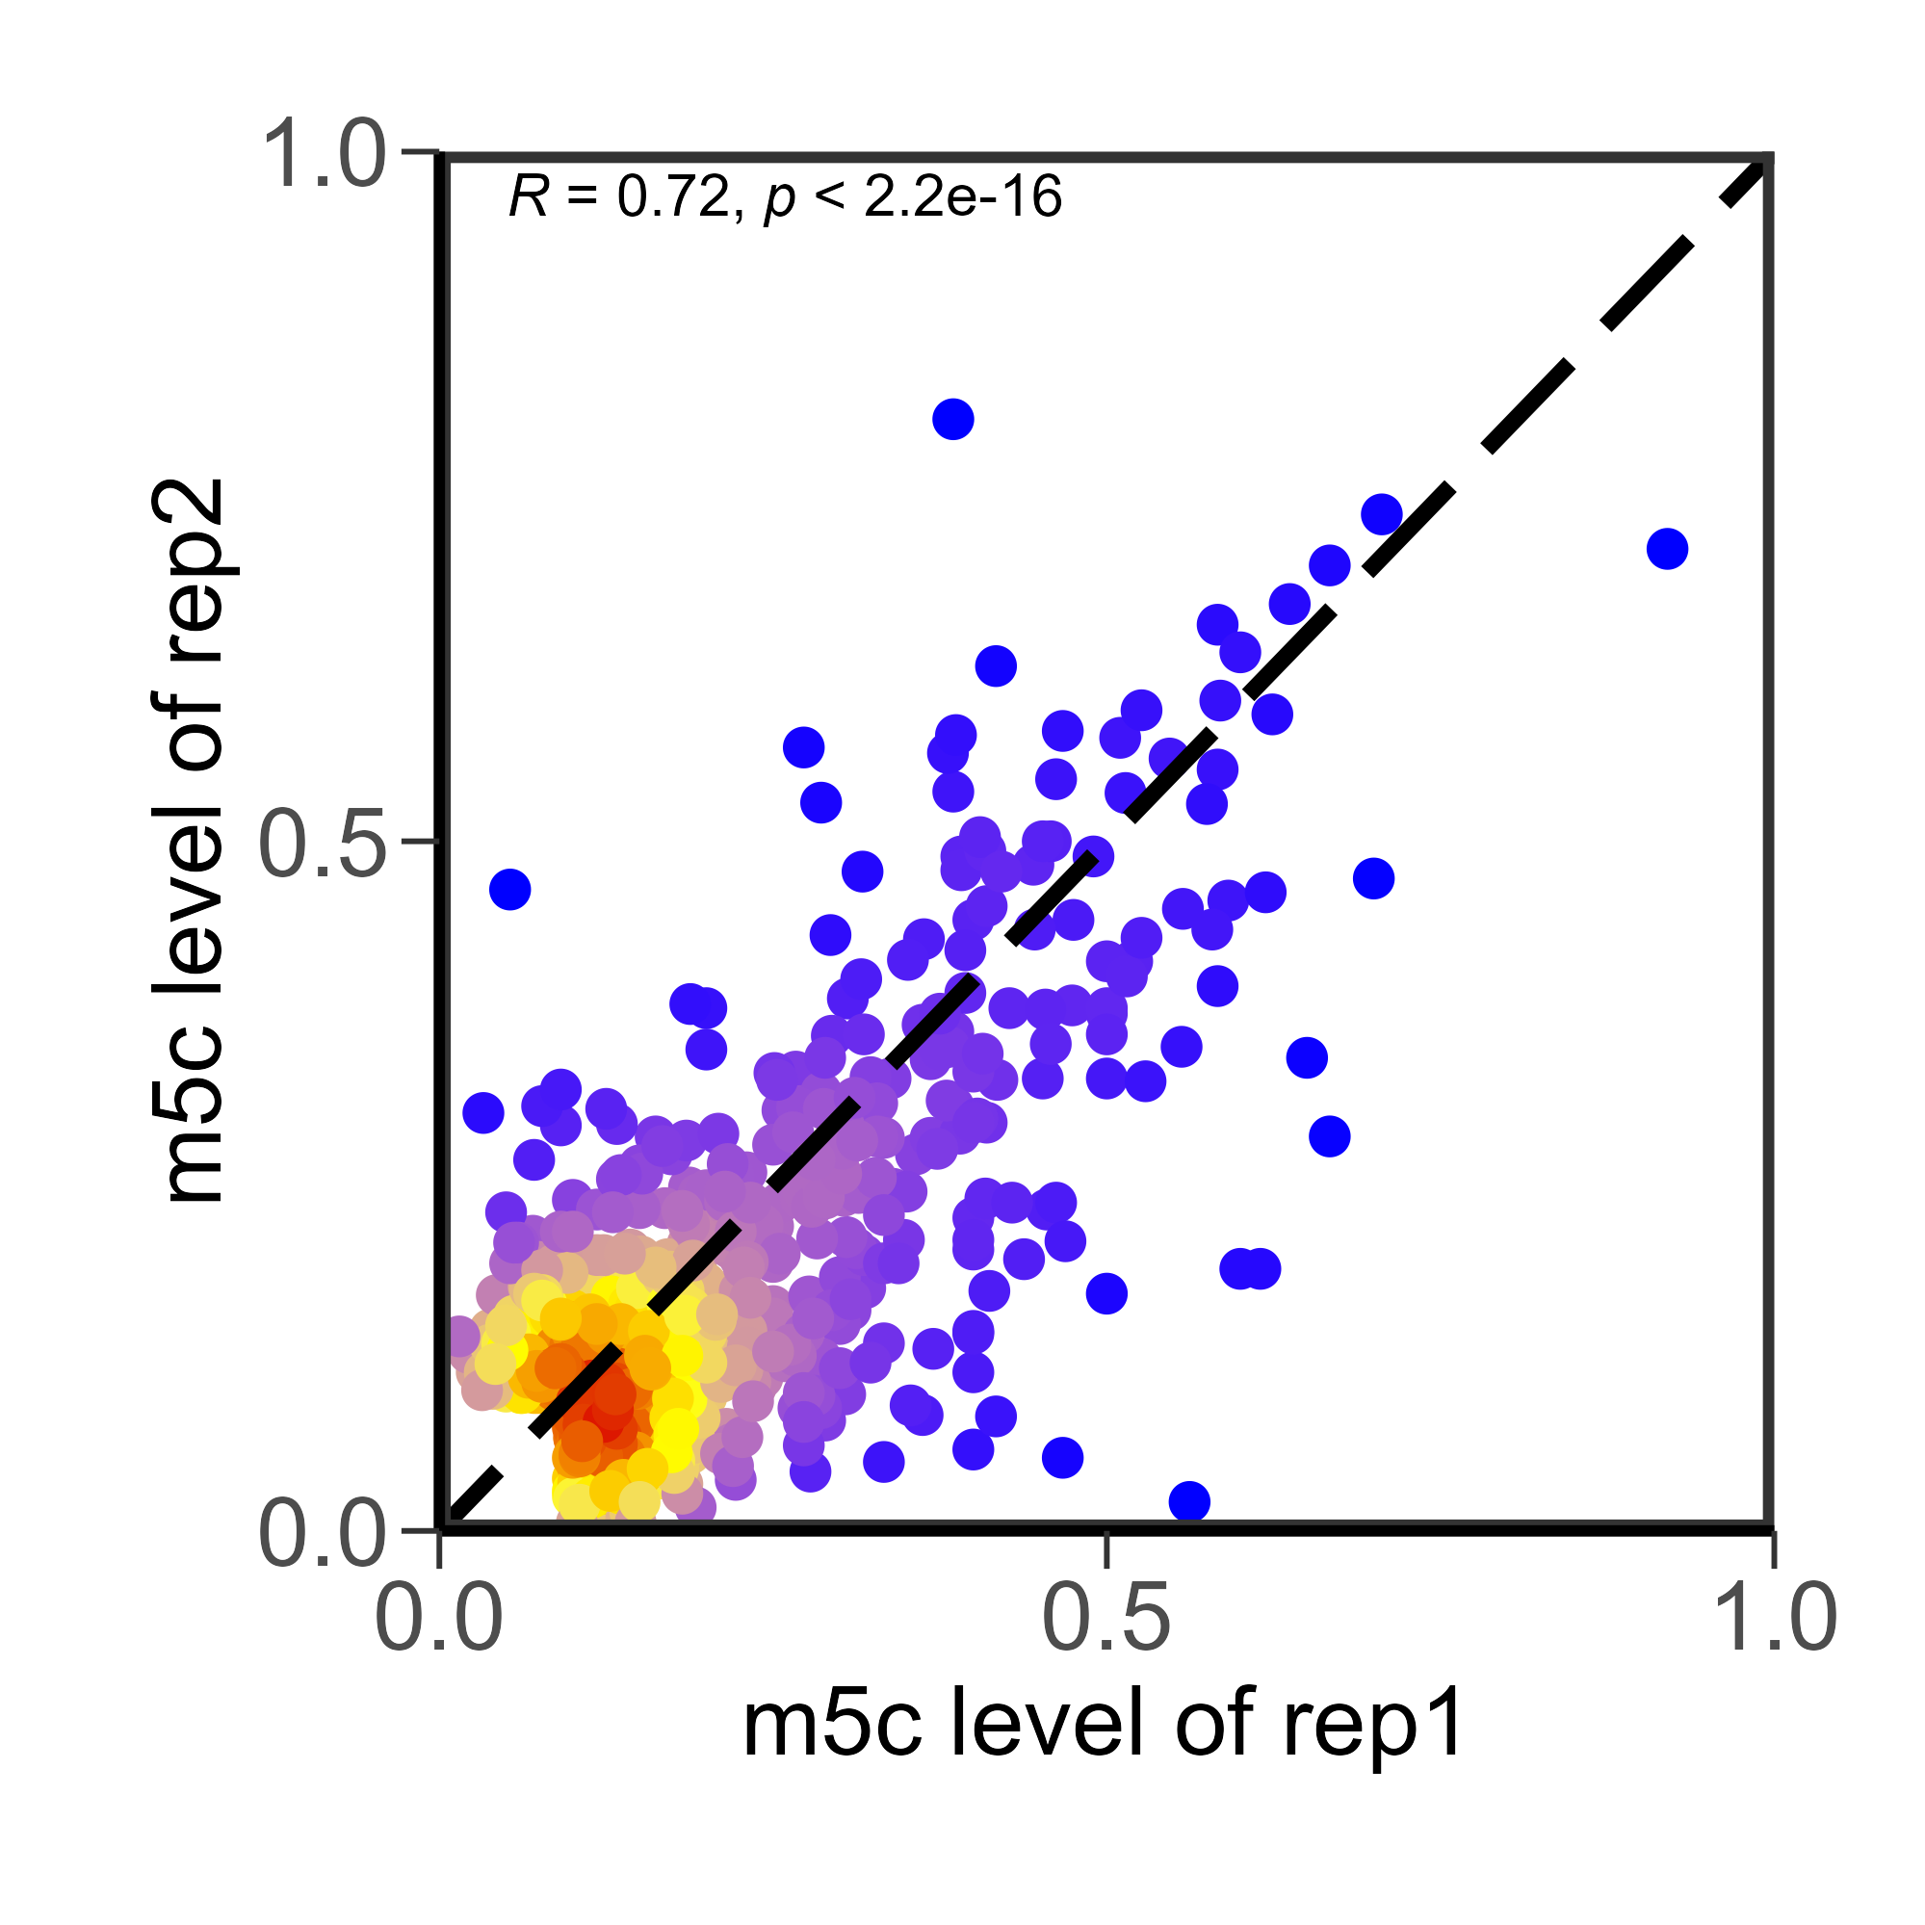
A
Total RNA
Huang libraries
1197
264
1118
Rep 2
Rep 3
Rep 1
207
160
Rep 4
19
40
39
294
20
273
155
Polysome RNA
788
1070
343
901
21
20
35
56
22
B
Total RNA
Polysome RNA
Huang rep1 v rep2

